Slide 1

CAC Co-Intelligence:
Learning with AI, Not from It
Version 2026 1015
Workshop Slides Template
A/Prof Sasha Nikolic
These workshop slides are shared as a template for designing activities within the CAC Co-Intelligence framework. They are open for use and adaptation, with acknowledgement. If you implement this approach, I would appreciate a short courtesy email outlining how it has been used and any observed impact.
sasha@uow.edu.au

Slide 2
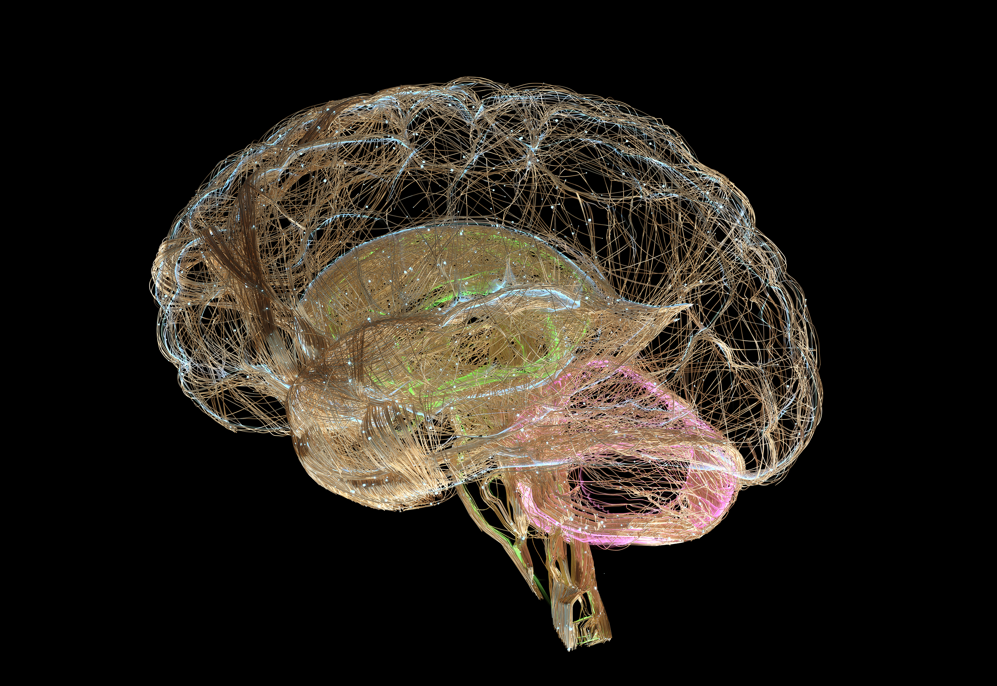

CAC Co-intelligence
AI
Cognitive
Cognitive
Think first
Plan & Prepare
Reflect on proven methods & ethical implications
How can AI enhance your work?
Apply as a supportive tool & not as your replacement
Which AI is the best fit?
Type/Model
AI outputs can be flawed
Apply Evaluative Judgment
Refine and validate AI outputs
Apply human touches, responsibility, and control
Dr Sasha Nikolic 2025

Slide 3
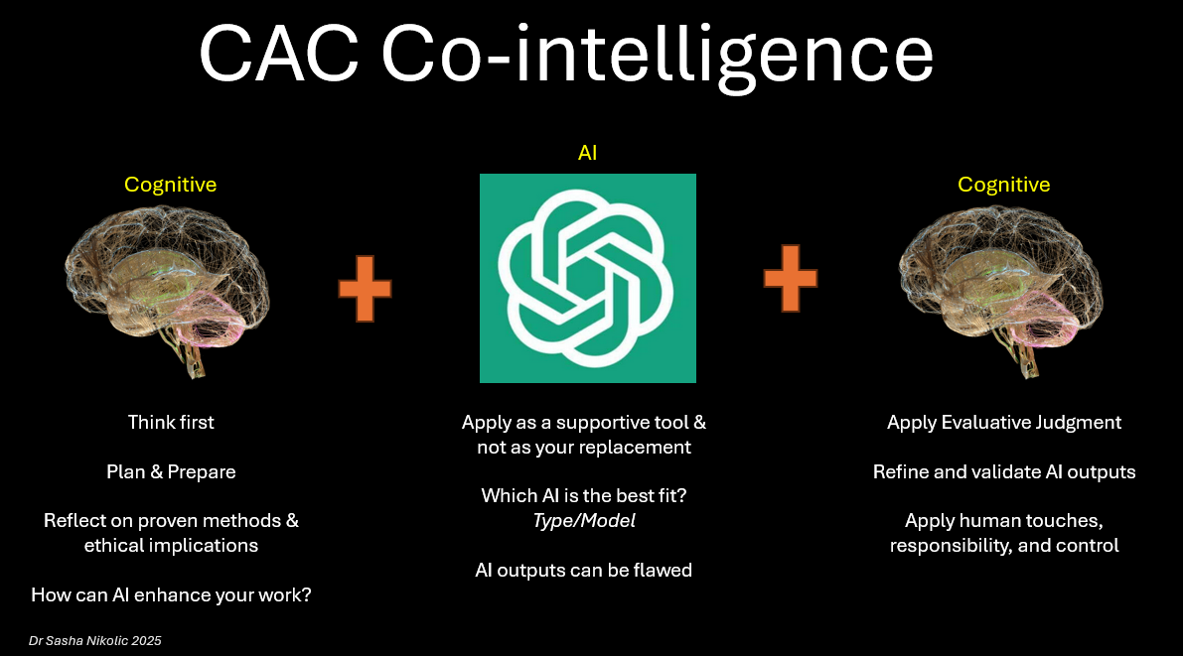
Workshop Activity
Topic
Step 1: Cognitive
  Outline your activity. Human (collaborative if possible) thinking only.
  In this step, student guidance includes:
  - Think first: Begin with deep reflection. Understand the problem, its context, and what truly needs solving before turning to AI. Develop pilot solutions so that human approaches are considered before being influenced by AI.
  - Plan & Prepare: Define the problem clearly, explore traditional or human-driven approaches first, and decide whether AI is genuinely the right tool for this task.
  - Reflect on proven methods & ethical implications: Draw on policy, existing knowledge and professional standards; anticipate potential ethical, security, or practical consequences of AI involvement (see here for possible implications). For example, when moving to step 2, is it ethical to engage the GenAI with the associated data? Discuss how learning occurs through this approach.
  - How can AI enhance your work?: Ask why you may wish to use AI. Is it necessary? Will it enhance the outcome, and which AI type or model best aligns with your goal?
Dr Sasha Nikolic 2025

Slide 4
Example Workshop Activity
GenAI Ethics & CAC Co-intelligence
Step 1: Cognitive
  Without using technology, each group is to list as many social, economic and environmental ethical implications of GenAI use as possible.
  Categorise as positive, negative or neutral
Example
Dr Sasha Nikolic 2025

Slide 5
Workshop Activity
Topic
Step 2: AI
  Outline your activity. Use AI as a reflective, supportive tool
  In this step, student guidance includes:
  - Apply as a supportive tool & not as your replacement: Treat AI as a collaborator (using an appropriate augmentation role) that enhances capability while preserving human direction and accountability. Use ethically. Discuss how learning occurs in this approach and contrast it with Step 1.
  - Which AI is the best fit? Type/Model: Select the right kind of AI (e.g., generative, predictive, analytical) to match your specific goal or problem.
  - AI outputs can be flawed: Remember that AI can generate errors or biases; critical review is essential before use. Discuss matters such as relevance and accuracy. Discuss differences in prompts and models.
Dr Sasha Nikolic 2025

Slide 6
Workshop Activity
Topic
Possible Augmentation Roles
Approach | Role or Function of AI | Student Outcome
Centaur | Performs delegated components of a task within a deliberate division of labour between human and AI | Strategic judgement and task allocation
Socratic AI | Questioner that probes understanding and encourages explanation | Reasoning and metacognition
Adversarial AI | Opponent or challenger that tests arguments and assumptions | Critical thinking and evaluative judgment
AI Tutor | Provides explanations, scaffolding, practice, and feedback | Knowledge and skill acquisition
Co-Creation | Creative partner in developing and refining ideas or solutions | Creativity, synthesis, and innovation
AI Environment | AI capabilities embedded within tools, workflows, or learning environments | Adaptability and informed AI use
Dr Sasha Nikolic 2025

Slide 7
Example Workshop Activity
GenAI Ethics & CAC Co-intelligence
Part 2: AI
  Each group now use a GenAI of your choice. Using the technology, can you increase the number of implications found in part 1? Do they belong to the same categories?
  Note: Do not make any adjustments from what the GenAI says.
Example
Dr Sasha Nikolic 2025

Slide 8
Workshop Activity
Topic
Step 3: Cognitive
  Synthesise results between steps 1 and 2
  In this step, student guidance includes:
  - Apply Evaluative Judgment: Assess AI results critically for accuracy, logic, and alignment with your intent and values. Discuss how learning and higher-order thinking occur through such synthesis.
  - Refine and validate AI outputs: Edit, verify, and contextualise results to ensure they meet human and professional standards. Discuss how this can be done.
  - Apply human touches, responsibility, and control: Integrate human voice, empathy, ethics, and ownership; maintaining human oversight over final outcomes.
  - Discuss how this process is inherently iterative. The final cognitive evaluation often leads to new questions, refinements, or directions, initiating another round of the cycle. Each cycle should build on the previous one, deepening understanding and improving judgment rather than simply repeating the same steps
Dr Sasha Nikolic 2025

Slide 9
Example Workshop Activity 2
GenAI Ethics & CAC Co-intelligence
Example
Step 3: Cognitive
  Each group must go through the results from Parts 1 and 2, and create a synthesised, completed version with all implications in the correct categories
  Then, the group must decide whether to proceed with their current solution or initiate another cycle by refining their approach and returning to Step 1 or 2.
Dr Sasha Nikolic 2025

Slide 10
Workshop Activity
Topic
Step 4:
  Class reflection, discussion and connection to assessment or other activities
Dr Sasha Nikolic 2025

Slide 11
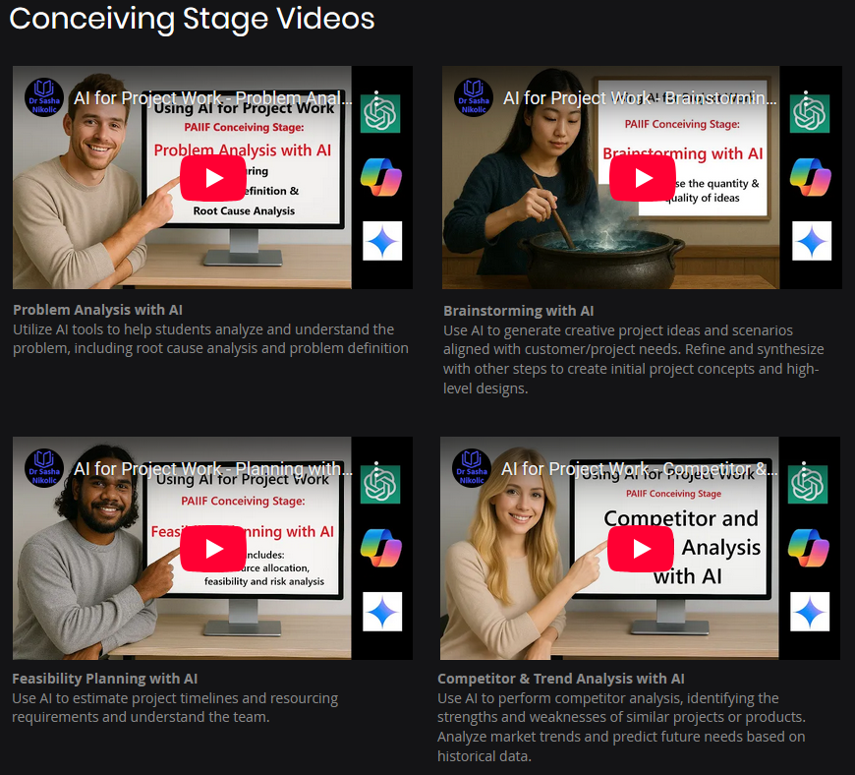
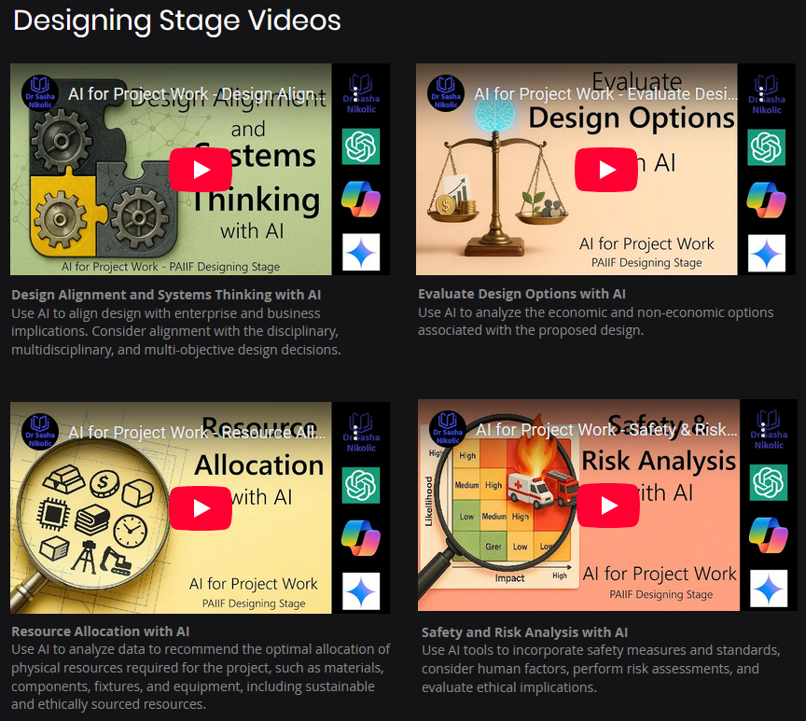


https://www.aaieec.org/projectwork

Slide 12
Resources
CAC Co-intelligence Overview: https://youtu.be/J3g9M3fIiJQ
Framework Details: https://www.sashanikolic.com/cac-co-intelligence
Dr Sasha Nikolic 2025

